Slide 1
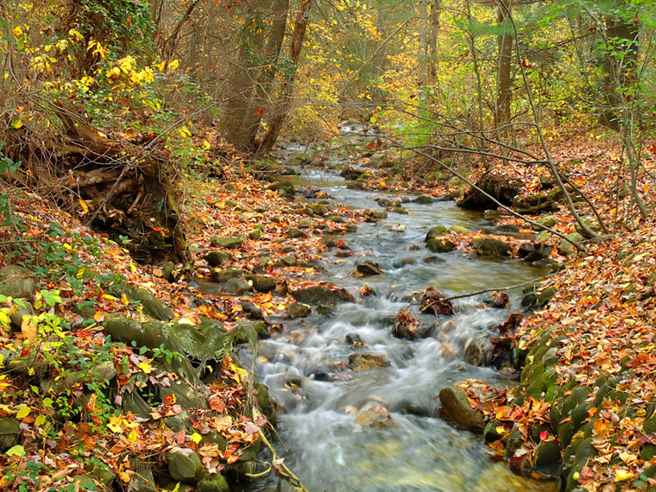
Welcome!
~ Upon Arrival ~
Refreshments and Check-in
Put your name on a post-it flag and place it where you work on the PA Water Basin map
PA certified teachers - Act 48 sign-in
MWEE 101 completion
Make your Nametag, include…
Name
Title
School or Organization
If a non-formal educator, add your organization to the inventory of PA Environmental Education Providers

Slide 2
Introduction to the Day
Welcome!
Goal for workshop: Participants become trained as MWEE Ambassadors
Objectives: Participants will...
Gain understanding and comfort with the MWEE as a framework for watershed education
Increase the intent of non-formal and formal educators to partner to support K-12 environmental literacy
Create connections across the state for watershed education resources and partners
MWEE Promotional Video: http://baybackpack.com/
Vision for MWEE Ambassadors

Slide 3
MWEE Ambassadors
So how do I fit in this puzzle?
Teacher & School leaders
School resources & other teachers
Fit learning activities, curricula units, and scope and sequence into MWEE
Framework
EE Provider partners
Expert in the field
Co-planner
Resources
Investigation site
Notes:
Strength of partnerships: Teachers are experts at their content in the classroom, standards; Non-formal educators bring real-world expertise in the field (career component)
Communicator: Know your audience; Adjust your message based on the audience; those in science fields are very good at science-speak, but that is a deterrent to average Americans
Co-Planner-working with classroom teachers and other partners to plan experiences; we all have our own resources we bring to the table; can help plan the experiences to get learners outside; ease teacher anxiety
MWEE Ambassador-help classroom teachers to formulate their ideas and the standards they cover into Meaningful Watershed Education Experiences (student-centered; real-world; locally relevant; hands-on; immersive learning)

Slide 4
PA Meaningful Watershed Educational Experience Ambassador Training
NOAA funded PA Environmental Literacy & MWEE Capacity-Building Project (Grant #s NA17NMF4570274,
& NA20NMF4570238,
& NA22NMF4570318,)

Slide 5
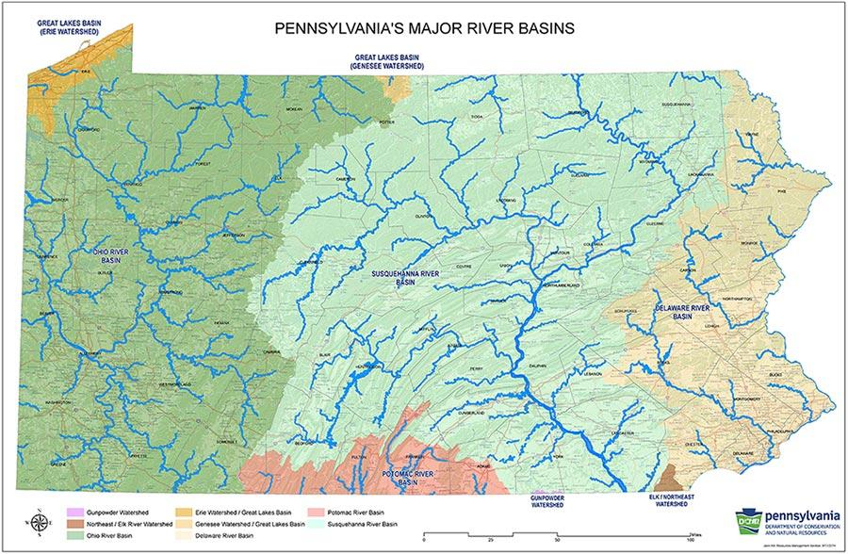
ACTIVITY: Which watersheds do we represent?
http://www.watersheded.dcnr.state.pa.us/
Click on MAPS
Notes:
Carissa
Everyone will receive a map to take home/laminated ones in swag
Participants will be from across the state. This can help situate them a bit. Ask them to look at a map of watersheds in PA, find where they teach, which watershed?

Slide 6
Visualizing PA’s Water Resources - Major River Basins
Pennsylvania has over 85,000 stream miles (second highest in the nation)
Notes:
Difference between this water basin map and the previous one (6 major basins vs. 8)

Slide 7
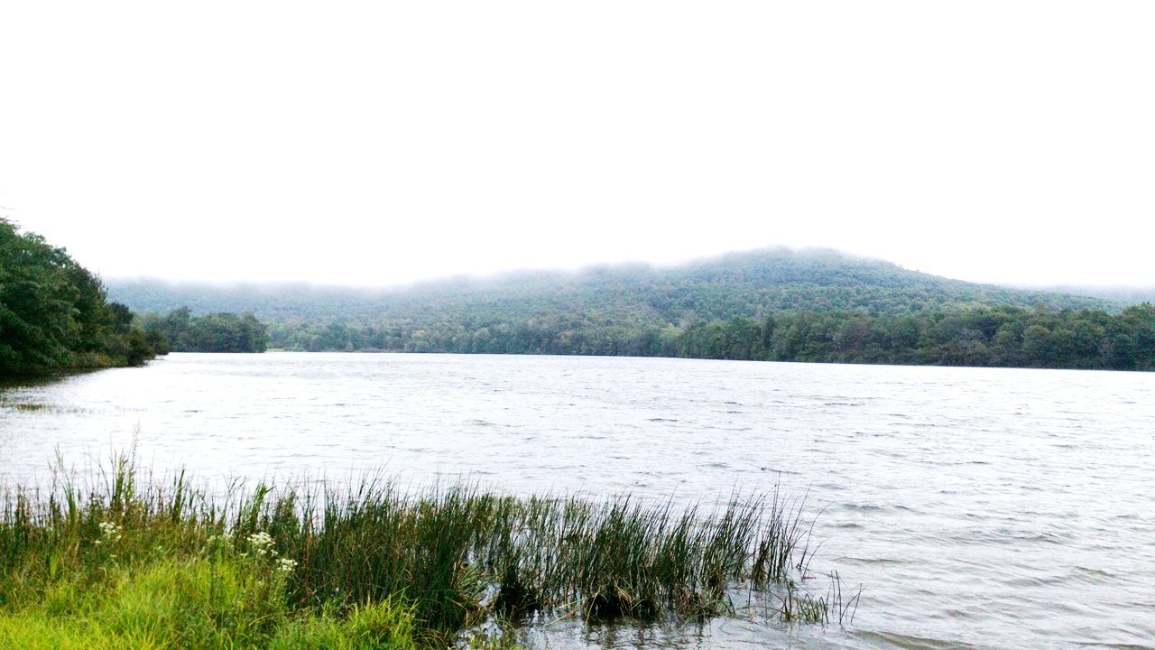
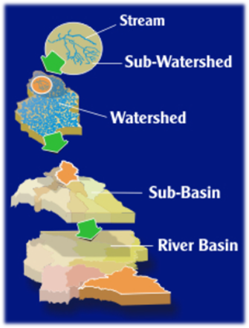
River Basin or Watershed?
River Basin
Large land area that is made up of many watersheds.
The BIG picture!
Watershed
Land area from which surface runoff drains into a stream, lake, reservoir, or other body of water.
A smaller snapshot!

Slide 8
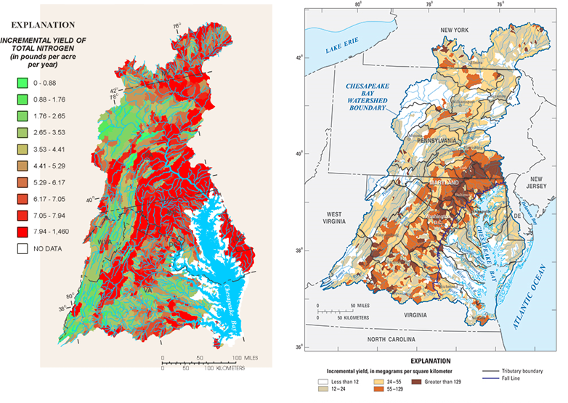
Visualizing PA’s Water Resources
- Chesapeake Bay Nutrient & Sediment

Slide 9
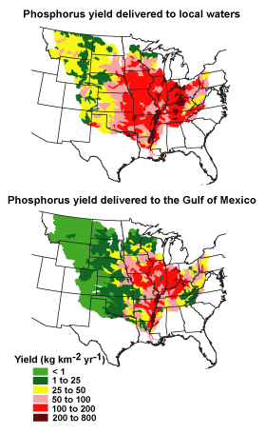
Visualizing PA’s Water Resources - Ohio and Delaware River Basins
Notes:
Nutrient and sediment loading issues of other PA major watersheds. Pink circles in N map for DE is outlets from lakes.

Slide 10
Visualizing PA’s Water Resources - Impaired Streams
Pennsylvania has over 18,000 impaired stream miles
Notes:
4 different ways to list as impaired:
Can’t support aquatic life as they should.
non-potable water (drinking water)
Can’t use for some or all forms of recreation. Again mostly because of nutrient and sediment loading.
Fish Consumption

Slide 11
EPA Oversight for Chesapeake Bay
Note: very similar for all PA watersheds
Notes:
Most current statement from EPA. PA is only state at backstop level. Backstop - PA needs to solve these issues now or US EPA will take over addressing the issues.

Slide 12
Visualizing PA’s Water Resources - Private Water Wells > 1 million wells!
Notes:
>1M private water wells in PA. Only state in country with NO state-wide regulations on well construction and well water quality testing. Some localities do have regulations. Fun facts: only about 14M private water wells in country; about 45% of private wells in PA have never been properly tested; about 40% of wells that have been tested were positive for coliform bacteria. Regulations do exist for public water systems - any organization that serves >25 people/day.

Slide 13
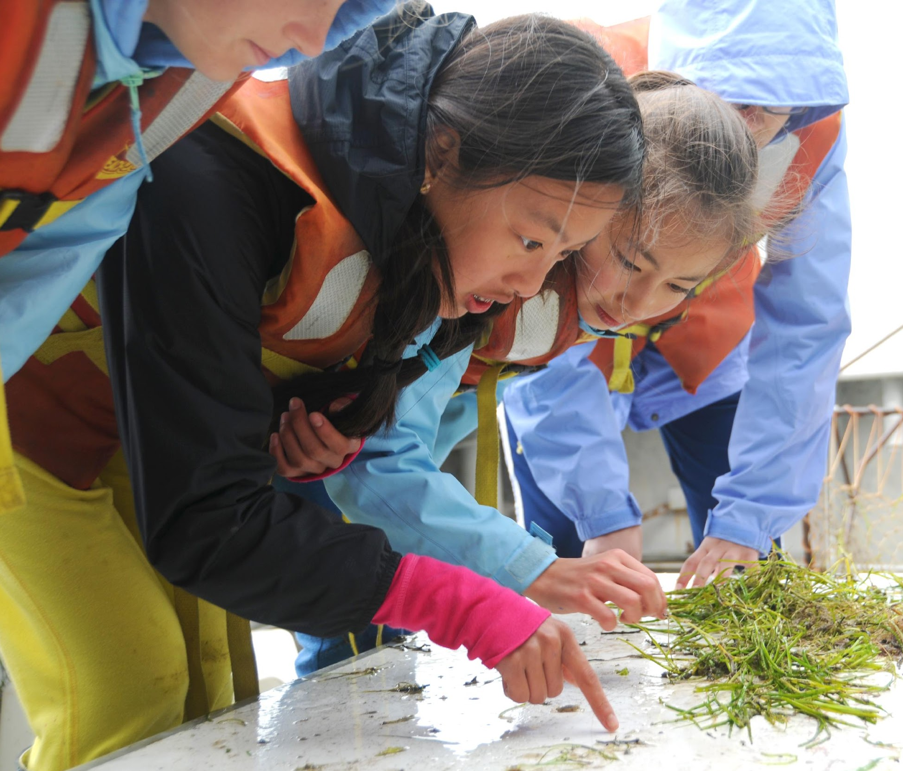
An Educator’s Guide
to the
Meaningful Watershed
Educational Experience
(MWEE)
To download the guide and find more information
http://baybackpack.com/mwee/what-is-a-mwee
NOAA-Online MWEE 101 training
https://cbexapp.noaa.gov/course/view.php?id=5555
Notes:
This “foundational” workshop has been designed with an audience of field-based educators, school-based educators, or both. (Thus ‘workshop for educators instead of ‘workshop for field-based, etc.)
Navigate through Baybackpack site as well as what the NOAA Online MWEE Training looks like

Slide 14
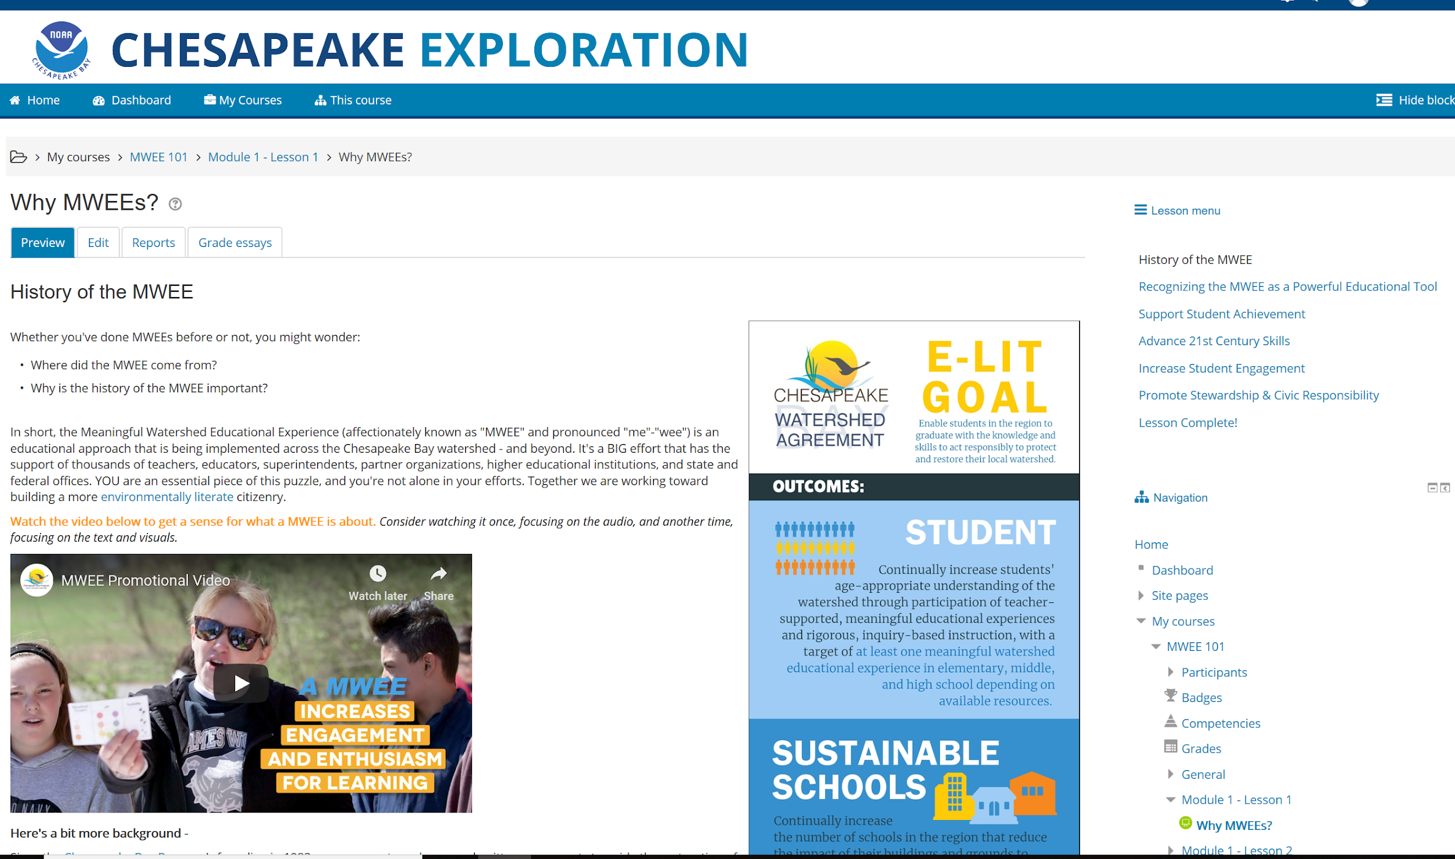
NOAA MWEE 101 Course

Slide 15
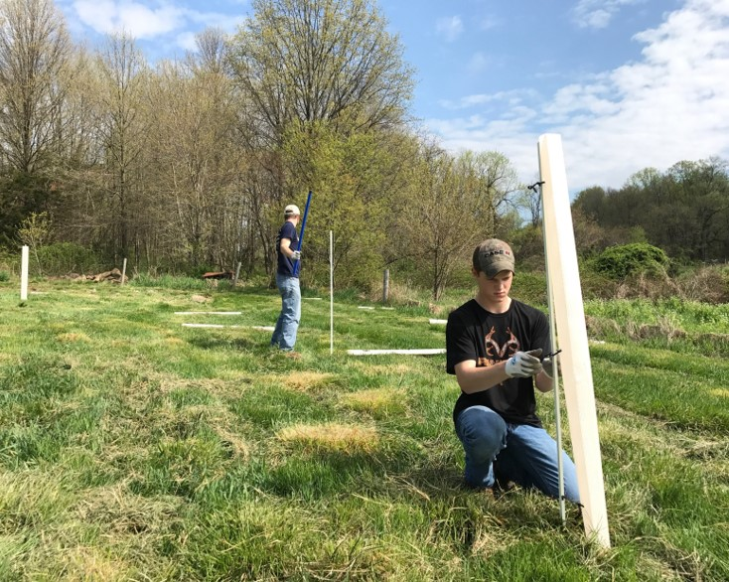
Meaningful Watershed Educational Experience (MWEE)
MWEEs support high-quality teaching and learning by actively engaging students in building knowledge and meaning through hands-on experiences.
MWEEs are a powerful educational tool that:
Increase student engagement & enthusiasm for learning
Support student achievement
Advance 21st century skills and career-readiness
Promote environmental stewardship & civic responsibility
Notes:
*This is how we accomplish the Watershed Agreement – Education through MWEEs. This is what MWEEs do, this is the end goal.
*PA has a gap in meeting that Environmental Literacy goal, but we see you all as being key experts in filling this gap

Slide 16
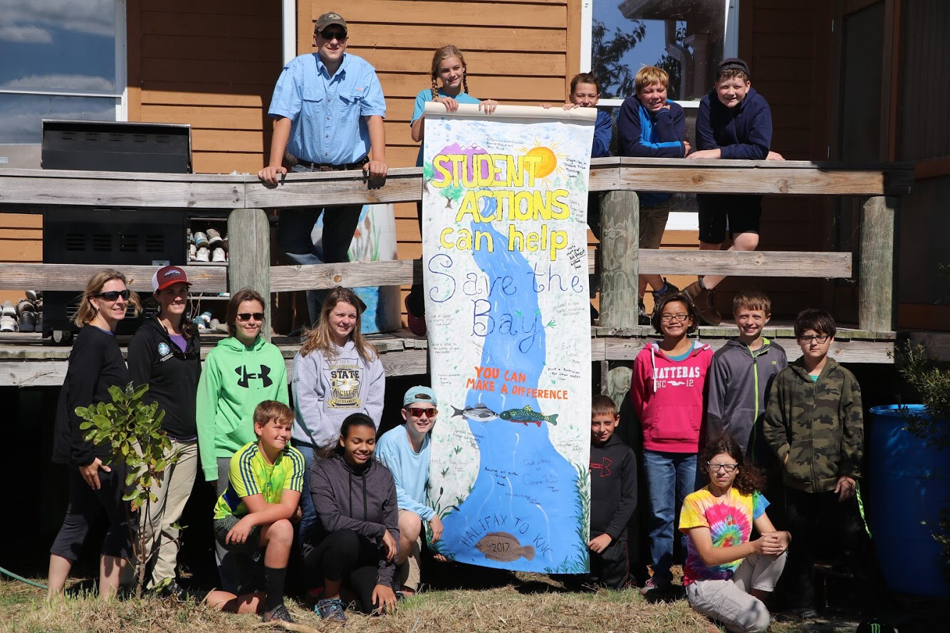
What are Meaningful Watershed Educational Experiences (MWEEs)?
MWEE Essential Elements
Issue Definition
1
Outdoor Field Experiences
2
Synthesis and Conclusions
3
Stewardship & Civic Action
Watershed restoration or protection
Civic action
Community engagement
Everyday choices
4
Notes:
MWEEs are:
MWEEs represent an instructional model that addresses the Environmental Literacy Goal of the Chesapeake Bay Watershed Agreement while working to integrate sustainability, environmental education, and field-based learning into curricular programs
This is how we apply MWEEs and use them to meet curricular goals.
Use the capture sheet here/Field Think Cloud/Show an example MWEE
*give example of: Issue Def, Outdoor Field, Sy & Con Action Project

Slide 17
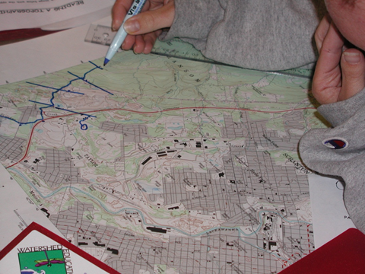
Issue Definition
Students focus on issue requiring background research and investigation
This looks like: classroom instruction, collection of data, conducting experiments, talking to experts, and reviewing credible publications
They reflect on their personal experiences and values related to the issue
Should be age appropriate and student centered
Notes:
MWEEs should be learner centered and focused on questions, problems, and issues to be investigated through collecting, analyzing and sharing data; learning protocols; exploring models; and examining natural phenomena
Students focus on an environmental question, problem, or issue requiring background research and investigation. They learn more about the issue through classroom instruction, the collection of data, conducting experiments, talking to experts and reviewing credible publications. This process should be age appropriate with practices growing in complexity and sophistication across the grades, starting with educator guided investigation and progressing to student-led inquiry.
Focus on a driving question tied to a locally relevant environmental issue, problem or phenomenon
Learn about the issue in classroom and field as well as meeting with experts and consulting publications
Connect to personal and public values
This looks like: classroom instruction, collection of data, conducting experiments, talking to experts, and reviewing credible publications
Students focus on an environmental question, problem, or issue requiring background research and investigation. They learn more about the issue through classroom instruction, the collection of data, conducting experiments and by talking to experts and reviewing credible publications. They also reflect on their personal experiences and values related to the issue. This process should be age appropriate with practices growing in complexity and sophistication across the grades, starting with educator guided investigation and progressing to student-led inquiry. As students mature, the level and complexity of inquiry will likewise progress.

Slide 18
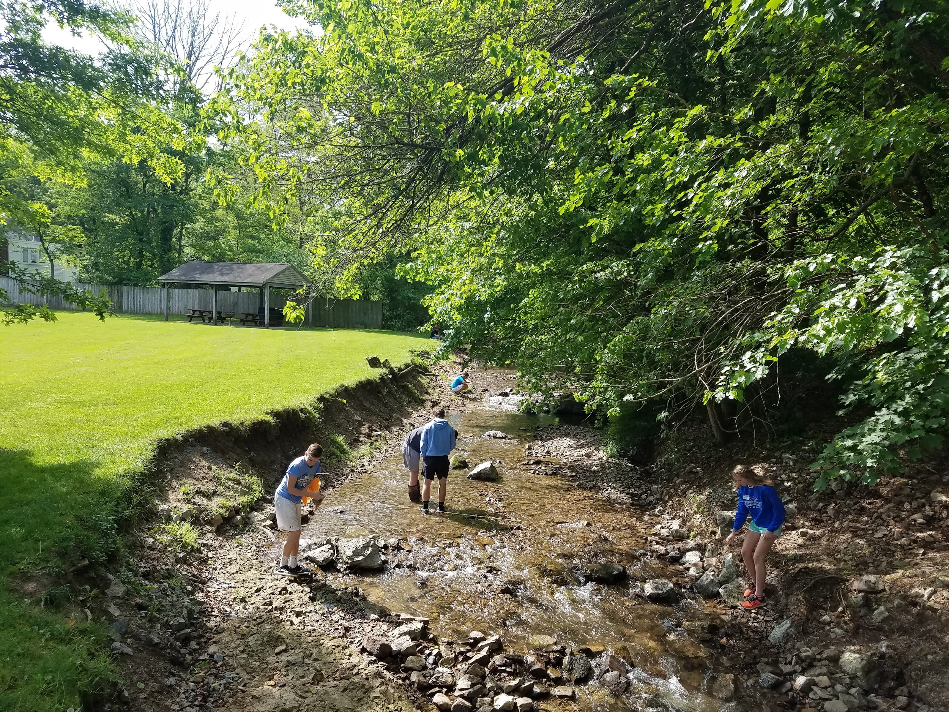
Outdoor Field Experiences
Students participate in one or more outdoor field experiences sufficient to collect the data required for answering the research questions and informing student actions
Can be traditional data collection for an experiment, but could also be more subjective in nature
Can be off site or on the school grounds
Notes:
Students participate in multiple outdoor field activities sufficient to collect the data or make observations required for answering the research questions and informing student actions, or as part of the issue definition and background research. Students should be actively involved in planning the investigation, taking measurements, or constructing the project within appropriate safety guidelines, with teachers providing instruction on methods and procedures, data collection protocols, and proper use of equipment as needed. These activities can take place off-site and/or on the school grounds.
Outdoor Experiences:
Sufficient to identify and/or investigate issue, problem or phenomenon
Help answer identify and answer questions as well as inform student action
On or off school property

Slide 19
Outdoor Field Experiences
Successes/Challenges
Supporting individual or group work outside
Connecting to class work
Assessing student learning
What learning happens best outside?

Slide 20
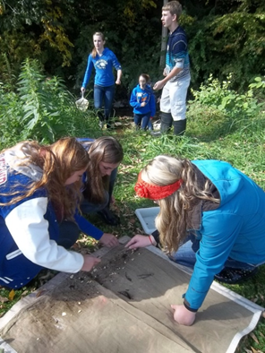
Synthesis and Conclusions
Allows students to “own” their actions and decisions
Students analyze and evaluate the results of their issue investigation
Students synthesize and communicate results and conclusions to external audiences
Notes:
Students analyze and evaluate the results of projects and investigations. Students synthesize and communicate results and conclusions to an external audience such as other classrooms, schools, parents, or the community.
Apply evidence from investigations to draw conclusions and make claims
Students communicate about conclusions
Allows students to “own” their actions and decisions

Slide 21
Stewardship and Civic Action
Students take action to address environmental issues at the personal or societal level
Action Projects can take many forms, but should be student directed to the extent possible…
Watershed Restoration or Protection (e.g., create schoolyard habitat, planting trees or grasses, invasive species removal, cleanup (e.g.,beach, stream, school, community), raise & release (e.g., fish, oysters, turtles), stormwater management (e.g., rain garden, paint storm drains)
Everyday Choices (e.g., reduce/reuse/recycle/upcycle, transportation (e.g., carpooling, bike riding, mass transit, walking), composting, energy conservation, water conservation)
Community Engagement (e.g., outreach, presentations, social media, messaging at community events/fairs/festivals, event-organizing, mentoring, PSAs, flyers, posters)
Civic Action (e.g., town meetings, voting, writing elected officials/decision makers, advocating for policy change)
Notes:
Before diving into issues with action projects, we want to emphasize that actions need not be hands-on restoration. They take many forms. This can help with age appropriateness and sustainability
Students participate in an age appropriate project during which they take action to address environmental issues at the personal or societal level.
Identify, explore and implement solutions
Evaluate/Reflect on actions to determine effectiveness at addressing the issue, problem, challenge…
Action Projects can take many forms, but should be student directed to the extent possible…
Watershed Restoration or Protection (e.g., create schoolyard habitat, planting trees or grasses, invasive species removal, community cleanup, stormwater management)
Everyday Choices (e.g., reduce/reuse/recycle/upcycle, composting, energy conservation, water conservation)
Community Engagement (e.g., presentations, social media, event-organizing, messaging at community events/fairs/festivals, mentoring, PSAs, flyers, posters)
Civic Action (e.g., town meetings, voting, writing elected officials/decision makers, meeting with elected officials to learn about policy aspects of watershed monitoring and habitat restoration)
Participants in B-WET MWEE activities should understand they have control over the outcome of environmental issues, be encouraged to identify actions to address these issues and understand the value of those actions.

Slide 22
Introducing Action Early
Have you been involved in environmental or social action?
How did you get involved?
What did it mean to you then? Now?
Notes:
See pages 22-24 in PA MWEE Facilitator’s Guide
https://docs.google.com/document/d/1Io7hxPZ5l4gwA8IvjSZDJSvx9OlOMxZvWGXMFN4xBQU/edit#heading=h.27mrty7u24py

Slide 23
How to achieve meaningful action
Factors influencing individual choices and actions
Perceived locus of control for affecting change
Degree of lasting impact on an individual’s stewardship behaviors
What are the benefits to engaging students in action?
What are some successes and challenges to engaging students in action?

Slide 24
Activity
Exploring Local Issues

Slide 25
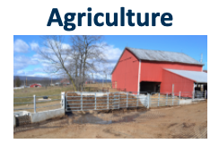
Meaningful Watershed Educational Experiences
Review the issue cards describing common issues/problems within Pennsylvania Watersheds
Determine which are local to you - Pick 3 to work with
Discuss issues based on natural systems and human systems and values
Notes:
Issue Cards: https://docs.google.com/document/d/1Fa_-_xrLsonEALo1kmgmiy3LzipjwBQUbPIEZ9DloLw/edit?usp=sharing
Brainstorm watershed issues in your area
Share the jamboard (see links below)
Look at all the issues - learn a bit about all (7mins) (Issue Cards: https://docs.google.com/document/d/149fwrOSWRYmsppfJgOJXEUjFUJzRiF9KgleuDME8Mgo/edit?usp=sharing; Local Issue Docs: https://docs.google.com/document/d/1Pyz_LMyHTmK2nFkvKkj4JWf1eI7L_4pTckGlu0Hj_N4/edit )
Ask are there any missing:
After exploring all the issues pick six that we want to work with - for efficiency consider deleting the ones that are less relevant
Using the 6 issue descriptor cards, label each issue based on natural systems, human systems and values. Be prepared to defend your labels. (pile the unused ones in a group)
Return to Main room at 10:10
Virtual Option: https://jamboard.google.com/d/16vcfupUkxuXy36-xwSNrvQJYm7auzL0ZO6qxJzXXr5g/edit?usp=sharing

Slide 26
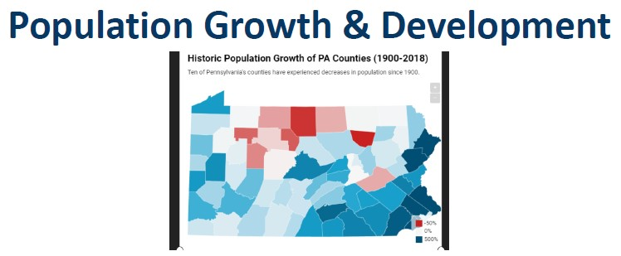
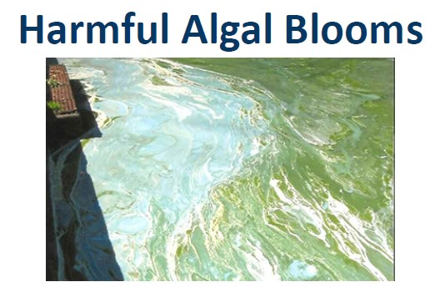
Meaningful Watershed Educational Experiences
What issues discussed are relevant to where you work and live?
Are you surprised by any of the issues identified?
Are there any major issues missing that are relevant to your community?
How else would you have students research locally relevant issues?

Slide 27
Outdoor Field Experience #1
Before we go outside…
What do we need to consider to make this a safe, effective, and manageable experience?
Notes:
Ask the group to brainstorm things to consider: classify them into categories: safety, class management and logistics
https://jamboard.google.com/d/103Hi7wwqNQw963ESQpmMcpQ_AztNBeEabJmoThdiTm4/edit?usp=sharing
Recognize and give voice to comfort levels-from hope and fears
Manage your own expectations. It’s okay if things change direction - embrace the learning moment. (share 4th grade story)
Key Point, if you do not have experience or comfort with student learning outside, Partners are key, consider engaging them. We are sending you some tools to give you some experience with the process. You are not expected to be the expert!
Link to preparing for an outdoor experience: state parks (Carissa Link)

Slide 28
Meaningful Watershed Educational Experiences
d Conclusion
Be prepared to report the following:
Briefly describe how your field work went.
What conclusions can be drawn based on the information and data you collected and synthesized?
Communicate (pictures/charts/graph) what your conclusions were and how they relate to the Driving Question and Local Issue.
What more do you need to know? Were there new questions that popped up? What additional research and/or data do you need now?
Notes:
Virtual Option: https://docs.google.com/presentation/d/1HMWV6pMvAiELH-AxZeUPGdV9r3KdBfDsiWVPbeoBHtY/edit?usp=sharing

Slide 29
Connecting MWEEs to PA Teaching & Learning
How can MWEEs help meet multiple state policies and standards, while also helping you meet your LEA’s needs?
Notes:
Tammie and Paul - 30 minutes before lunch + 15 minutes after lunch. Use MWEE supporting practices as the starter slide after lunch.
Ask the group to brainstorm things to consider: classify them into categories: safety, class management and logistics
https://jamboard.google.com/d/103Hi7wwqNQw963ESQpmMcpQ_AztNBeEabJmoThdiTm4/edit?usp=sharing
Recognize and give voice to comfort levels-from hope and fears
Manage your own expectations. It’s okay if things change direction - embrace the learning moment. (share 4th grade story)
Key Point, if you do not have experience or comfort with student learning outside, Partners are key, consider engaging them. We are sending you some tools to give you some experience with the process. You are not expected to be the expert!
Link to preparing for an outdoor experience: state parks (Carissa Link)

Slide 30
PDE Mission
Ensure that every learner has access to a world-class education system that academically prepares children and adults to succeed as productive citizens.
ACCESS
Establish a culture that is committed to improving opportunities throughout the commonwealth by ensuring that technical support, resources, and optima; learning environments are available for all students whether children or adults.
CULTURE

Slide 31
PDE Environment & Ecology Guidance/Authority
National Environmental Education Act (1990)​
PA Environmental Education Act (1993, 2007, 2008)​
PA Environmental Literacy Plan​
PA Advisory Council on Environmental Education​
Chesapeake Bay Watershed Agreement​
Delaware River Basin Commission ​
International Joint Commission (Great Lakes)​
United Nations Sustainability Goals

Slide 32
Chesapeake Bay Watershed Agreement:
Environmental Literacy Goal
Student
Continually increase students’ age-appropriate understanding of the watershed through participation in teacher-supported, meaningful watershed educational experiences and rigorous, inquiry-based instruction, with a target of at least one meaningful watershed educational experience in elementary, middle and high school depending on available resources.
2. Sustainable Schools
Continually increase the number of schools in the region that reduce the impact of their buildings and grounds on their local watershed, environment and human health through best practices, including student-led protection and restoration projects.
3. Environmental Literacy Planning
Each participating Bay jurisdiction should develop a comprehensive and systemic approach to environmental literacy for all students in the region that includes policies, practices and voluntary metrics that support the environmental literacy Goals and Outcomes of this Agreement.
https://www.chesapeakebay.net/what/goals/environmental_literacy
Notes:
Here are the outcomes:

Slide 33
Three Key Pieces: Policy and Programs
Pennsylvania Environmental Education Act
PA Pathways to Green Schools
Notes:
PDE Mission:
Ensure that every learner has access to a world-class education system that academically prepares children and adults to succeed as productive citizens.
Establish a culture that is committed to improving opportunities throughout the commonwealth by ensuring that technical support, resources, and optimal learning environments are available for all students, whether children or adults. Using Environment & Ecology context as themes for lesson, unit, and curriculum development.
PA Environmental Education Act (1993, 2007, 2008)
Modeled after National Environmental Education Act (1990)
Chesapeake Bay Watershed Agreement (2015)
PA Advisory Council on Environmental Education
PA Environmental Literacy Plan (2015) in support of ESSA and No Child Left inside act of 2015
Applys the essence of the CBWA to the entire state. PA drainst into not only the CBWA but to the OHio/Mississippi/Gulf of Mexico
PA Academic Standards (EE & Science and Technology)
United Nations Sustainability Goals
Belgrade Charter
Tbilisi Agreement’’Delaware River Basin Commission
International Joint Commission (Great Lakes)
PA EE Act
https://www.legis.state.pa.us/cfdocs/Legis/LI/uconsCheck.cfm?txtType=PDF&yr=1993&sessInd=0&smthLwInd=0&act=0024.
Defines PA Advisory Council on EE who developed the state level ELIT plan - 2015
https://www.education.pa.gov/Teachers%20-%20Administrators/GreenSchools/Pages/default.aspx
Tammie
PDE Mission:
Ensure that every learner has access to a world-class education system that academically prepares children and adults to succeed as productive citizens.
Establish a culture that is committed to improving opportunities throughout the commonwealth by ensuring that technical support, resources, and optimal learning environments are available for all students, whether children or adults. Using Environment & Ecology context as themes for lesson, unit, and curriculum development.
PA Environmental Education Act (1993, 2007, 2008)
Modeled after National Environmental Education Act (1990)
Chesapeake Bay Watershed Agreement (2015)
PA Advisory Council on Environmental Education
PA Environmental Literacy Plan (2015) in support of ESSA and No Child Left inside act of 2015
Applys the essence of the CBWA to the entire state. PA drainst into not only the CBWA but to the OHio/Mississippi/Gulf of Mexico
PA Academic Standards (EE & Science and Technology)
United Nations Sustainability Goals
Belgrade Charter
Tbilisi Agreement’’Delaware River Basin Commission
International Joint Commission (Great Lakes)

Slide 34
PA Environmental Literacy Plan
Recommendations | Action Steps Providers
School System - Recommendation 3: Engage students in meaningful outdoor learning experiences to address the PA Academic Standards (Chapter 4). | 1. Incorporate meaningful outdoor learning experiences at the primary, intermediate, middle and high school levels. 2. Utilize environmentally- oriented service learning and citizen science projects throughout the K-12 continuum to solidify student environmental literacy. | 3. Work to encourage environmental related after-school and summer enrichment programs for students. 4. Promote the use of real world environmental concerns in project based learning experiences.
Life Long Learner Recommendation 5 Provide environmental learning opportunities to a diverse population not currently represented in the leadership or decision making. | 1. Engage minority and stakeholder groups so that all stakeholders have equitable access to environmental education. | School districts, higher education, conservation districts, environmental non-profits, governmental agencies, businesses, industries, Penn State Cooperative Extension and/or families
Examines 8 focus areas:
The School System
Life-Long Learners and Civic Engagement
Sustainable Practices, Healthy Living and the Environment
Funding and Implementation
Partnerships
Early Childhood Education
Pre-Service Education
Professional Development
Notes:
PA Elit Plan,
The Governor of Pennsylvania along with eight neighboring governors and federal agencies have re-affirmed the commitment to work cooperatively for the purpose of creating a more environmentally and economically sustainable Chesapeake Bay watershed.
Mid-Atlantic Environmental Literacy Goal and the outcomes, each state is responsible to develop a state-specific environmental literacy plan by collaborating with vital partners representing state agencies, organizations and associations. (Our first was written in 2013, it was re written in 2015, to incorporate aspects of the NO CHild Left in Inside Act 2015. Unfortunately it didn’t get much attention in the formal education world the time because there was no one in my position from April 2012 to January 2019.
Modeled after components of CBWA but integrated NAAEE guidance points as well
Applies to whole state as recommendations designed by interagency PA ACEE and issupported by all partner agencies
LEA Env Lit Plans
Structured around Green Ribbon School Pillars with added pieces
https://docs.google.com/document/d/15fEL7OHdNZEKbeiYk-VAOrhbS0a1FqtJ2TtGLBHHt1g/edit?usp=sharing

Slide 35
Pennsylvania Environmental Literacy Plan (Statewide)
https://naaee.org/eepro/resources/pennsylvania-elp
2018-2019 Environmental Literacy Planning and Management Strategy
https://www.chesapeakebay.net/documents/22071/2018-2019_environmental_literacy_planning_management_strategy.pdf
Logic Plan and Work Plan
https://www.chesapeakebay.net/documents/22069/2018-2019_environmental_literacy_students_workplan.pdf
Chesapeake Bay Agreement (Final Signed Document)
https://www.epa.gov/sites/production/files/2016-01/documents/attachment1chesapeakebaywatershedagreement.pdf

Slide 36
Academic Standards
Environment and Sustainability Education, as a large construct bridges nearly all of PA’s Academic Standards
The study of the watershed aligns directly to three of PA’s current academic standard discipline areas
It can also easily integrate components of math, history, economics, civics, ELA, music, world languages.
Environment Literacy and Sustainability
Science Domains
Technology & Engineering
Notes:
National Standards also Support components of Environmental Literacy
NGSS
National Social Studies Standards (

Slide 37
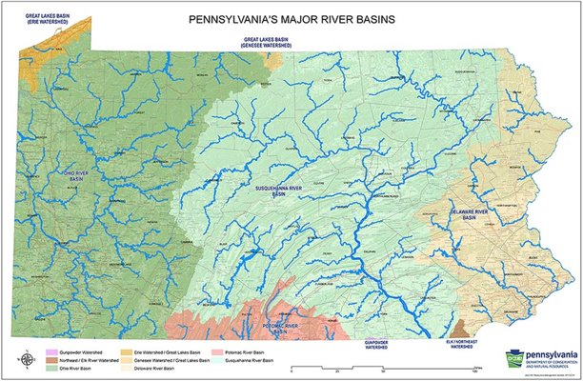
PA Environmental Literacy and Sustainability Standards call for LOCAL focus
The focus of environmental education should be on local and regional issues.
Help students take ownership of local and regional issues before focusing on global issues

Slide 38
A pathway to the future!
Informed by discussions with the PA STEM Coalition and other stakeholders across the state and nation
Notes:
300,000 new jobs by 2026 in Pennsylvania
8 of the 20 fastest growing jobs in STEM did not exist 10 years ago: Occupations like data scientist, App Developer, Cloud Specialist, Digital Marketer
In Pennsylvania
STEM – H or STEM Healthcare jobs have an annual demand gap of 5,300 jobs through 2026
Utility Systems Constructions will grow at a rate of 34% per year
9.2 million STEM jobs in the US by 2020
Educators wanted to teach skills like: Critical thinking, problem solving, communicating, computational thinking project management.
94% of Pennsylvania Libraries offer STEM programing
30% of libraries work with local LEAs on STEM programming

Slide 39
How do you see an LEA, IU, or school level Environmental Literacy & Sustainability Plan helping the implementation and continuation of a MWEE?
Notes:
Tammie/Paul

Slide 40
Continue discussions about what MWEEs would look like in your setting.
What supports may be needed?

Slide 41
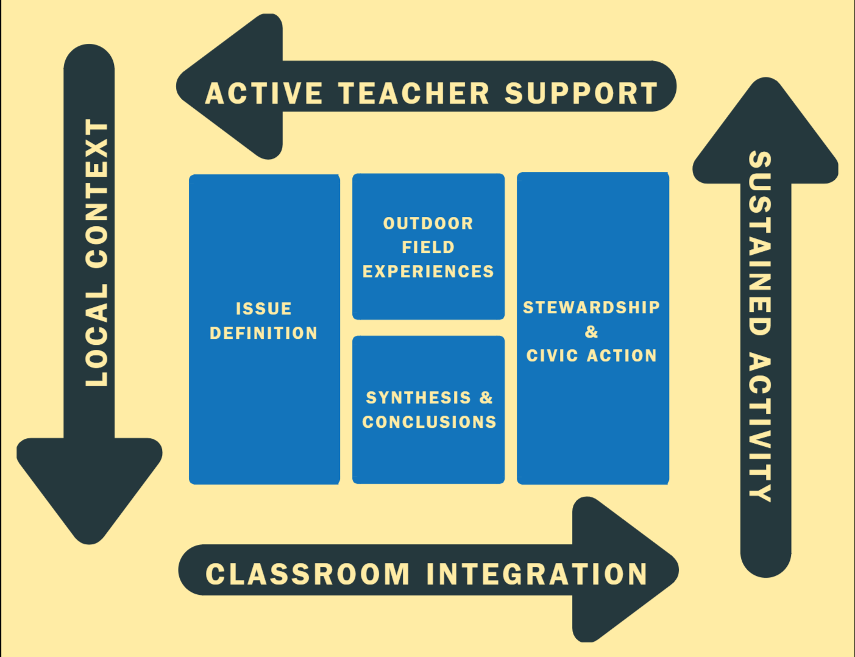
Essential
Elements
&
Supporting Practices
Notes:
Tammie
Quick questions/reflections on MWEE 101 experience
SUPPORTING PRACTICES = just as we model with you, it continues to teacher and on to students
Not a one hit wonder

Slide 42
MWEE Supporting Practices &
Examples from Teacher Perspectives
Active Teacher Support
Ensures essential elements support academic goals, teacher as facilitator/guide
Classroom Integration
MWEEs anchored in standards & curriculum scope and sequence, opportunities for interdisciplinary learning
Local Context
Relevancy, enables individual and collective decisions to affect immediate surroundings
Sustained Activity
Activities that engage students throughout the whole MWEE

Slide 43
Partnerships
Who from your community can help?
Which MWEE Essential Elements can they help with?
Notes:
Ask the group to brainstorm things to consider: classify them into categories: safety, class management and logistics
https://jamboard.google.com/d/103Hi7wwqNQw963ESQpmMcpQ_AztNBeEabJmoThdiTm4/edit?usp=sharing
Recognize and give voice to comfort levels-from hope and fears
Manage your own expectations. It’s okay if things change direction - embrace the learning moment. (share 4th grade story)
Key Point, if you do not have experience or comfort with student learning outside, Partners are key, consider engaging them. We are sending you some tools to give you some experience with the process. You are not expected to be the expert!
Link to preparing for an outdoor experience: state parks (Carissa Link)

Slide 44
Notes:
Carissa speaking. Megan is sharing her screen & the advancing slides. FIND YOUR MWEE PARTNERS! Find Environmental Education (EE) Providers in PA -
Are you looking for an EE organization to partner with, lead a MWEE field experience, assist with a MWEE program, or facilitate professional development? PA has over 475 environmental education providers! These organizations provide EE programming (including MWEEs) and professional development trainings.
The PA EE Providers Network – http://www.paee.net/find-ee-near-me.html

Slide 45
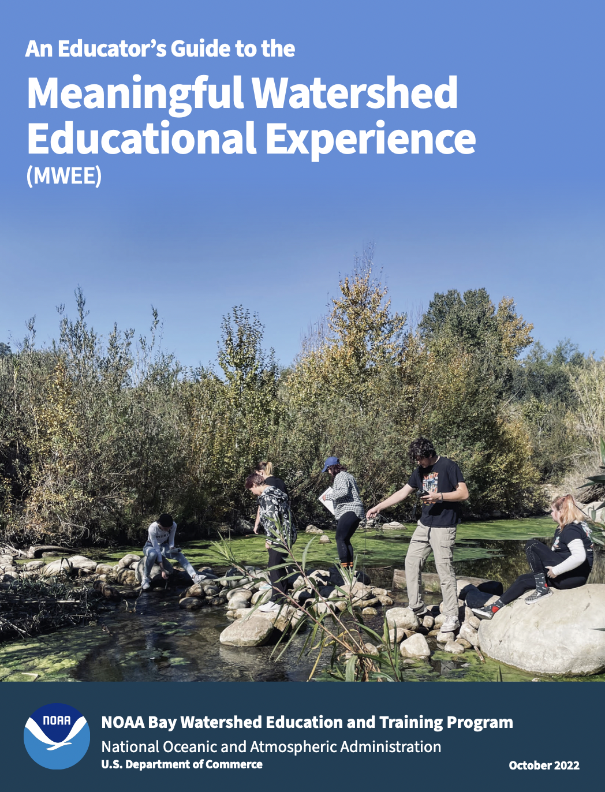
Explore nearby Outdoor Field Experience Locations
EE PROVIDERS
IN PA
WWW.PAEE.NET/
FIND-EE-NEAR-ME
WIKI WATERSHED - TOOLS
HTTPS://WIKIWATERSHED.ORG
Notes:
[Make additions/subtractions and sub out webpages based on the location of your workshop]
Use Wiki Watershed
Another example https://www.paimapinvasives.org/
Local parks, Conservancies, land trusts, museums, botanical gardens, community gardens, playgrounds, parking lots

Slide 46
Collaborate with PDE and other state resources

Slide 47
Alliance for Watershed Education,
William Penn Foundation
Alliance for Watershed Education of the Delaware River Basin https://www.watershedalliance.org/
23 environmental education centers in NJ, PA, & DE
Each of the centers are located on the circuit trail, or major connecting trail, and on waterways throughout the Delaware River watershed
Mission is to collectively increase and enhance constituent appreciation, knowledge, and stewardship of the Delaware River watershed
Joint programming like annual River Days events and shared best practices to increase collective impact

Slide 48
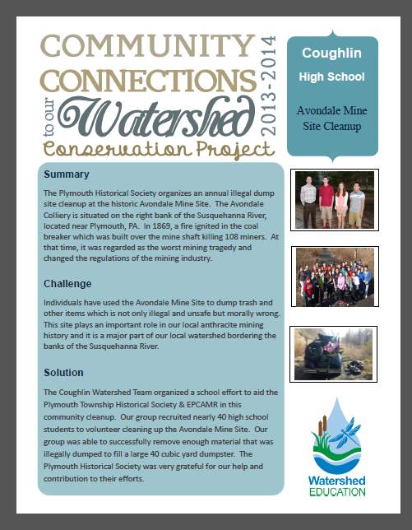
Partnership Examples
Lancaster Area Outdoor Learning Network Initiative (OLNI)
Lancaster, Ephrata, Columbia School Districts
Stroud Water Research Center, Millersville University, Lancaster County Conservation District as Backbone Partners
Focus on teacher PD, assistance and writing of MWEE curricular units, and implementation
PA State Parks Community Connections Watershed Forum
Stroud Water Research Center and West Chester Area School District.

Slide 49
Outdoor Field Experience #2
Before we go outside…
What do we need to consider to make this a safe, effective, and manageable experience?
Notes:
Ask the group to brainstorm things to consider: classify them into categories: safety, class management and logistics
https://jamboard.google.com/d/103Hi7wwqNQw963ESQpmMcpQ_AztNBeEabJmoThdiTm4/edit?usp=sharing
Recognize and give voice to comfort levels-from hope and fears
Manage your own expectations. It’s okay if things change direction - embrace the learning moment. (share 4th grade story)
Key Point, if you do not have experience or comfort with student learning outside, Partners are key, consider engaging them. We are sending you some tools to give you some experience with the process. You are not expected to be the expert!
Link to preparing for an outdoor experience: state parks (Carissa Link)

Slide 50
Finding Funding &
Other Resources
Notes:
Ask the group to brainstorm things to consider: classify them into categories: safety, class management and logistics
https://jamboard.google.com/d/103Hi7wwqNQw963ESQpmMcpQ_AztNBeEabJmoThdiTm4/edit?usp=sharing
Recognize and give voice to comfort levels-from hope and fears
Manage your own expectations. It’s okay if things change direction - embrace the learning moment. (share 4th grade story)
Key Point, if you do not have experience or comfort with student learning outside, Partners are key, consider engaging them. We are sending you some tools to give you some experience with the process. You are not expected to be the expert!
Link to preparing for an outdoor experience: state parks (Carissa Link)

Slide 51
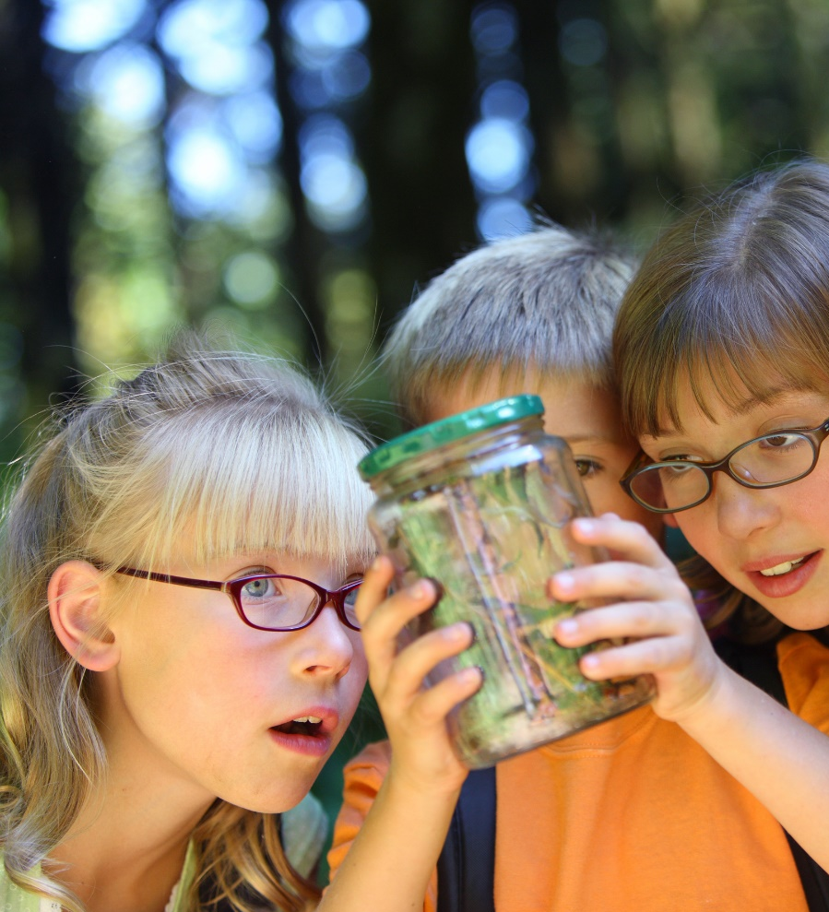
Federal Education Funds for Environmental & Outdoor Learning

Slide 52
Using COVID Relief Funds
Bill | Date Passed | Total Funding | K12 Public Schools Allocation | % Funds to LEAs | Must be obligated by
CARES Act | March, 2020 | $2.2 Trillion | $13.5 Billion | 90% | Dec.30,2021
Supplemental CARES Act | Dec. 2020 | $900 Billion | $54.3 Billion | 90% | Sept.30, 2022*
American Rescue Plan | March 2021 | $1.9 Trillion | $122 Billion | 90% | Sept 30, 2023*
Total |  | $5 Trillion | $189.8
*Under the Tydings Amendment, Section 412(B) of the General Education Provisions Act, 20 U.S.C. 1225(B), any funds not obligated at the end of the initial federal funding period shall remain available for an additional period of 12 months, giving LEAs another year to obligate funds from these packages

Slide 53
Broad & flexible use of funding
Social emotional learning, addressing learning loss, providing a safe and healthy learning environment, enrichment and out of school time programs
Anything currently eligible under existing law!
Lots of good examples around the country for portions of funds committed to outdoor classrooms, field experiences for students, outdoor learning, staffing, and more

Slide 54
How ARP ESSER Funds break down in our Region
STATE | Total ARP ESSER Fund Allocation | Minimum LEA Distribution (90%) | Maximum SEA Reservation* (10%) | Maximum For SEA Administration (½ of 1%)
Delaware | 410,733,965 | 369,660,568 | 41,073,397 | 2,053,670
Maryland | 1,951,136,802 | 1,756,023,122 | 195,113,680 | 9,755,684
Pennsylvania | 4,996,953,151 | 4,497,257,836 | 499,695,315 | 24,984,766
Virginia | 2,109,490,751 | 1,898,541,676 | 210,949,075 | 10,547,454
*Each SEA must reserve, at a minimum, 7 percent of its total allocation as follows: 5 percent for interventions to address learning loss, 1 percent for summer enrichment programs, and 1 percent for comprehensive afterschool programs.
Notes:
Elementary and Secondary School Emergency Relief Fund

Slide 55
EE in the Every Student Succeeds Act

Slide 56
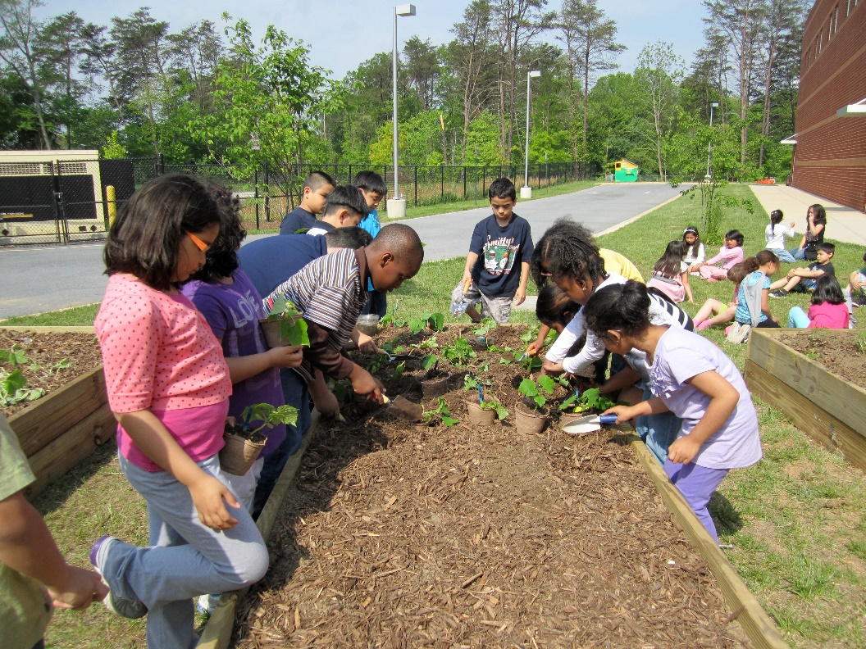
Title IV of ESSA: 21st Century Schools
Part A: Student Success and Enrichment Activities
Block grant to school districts to support a range of activities, including environmental education and hands-on field based and service learning STEM activities.

Slide 57
Title IV of ESSA: 21st Century Schools
Part B: 21st CCLC
Competitive grant program to schools and/or school system partners for after school and out of school time programs, including environmental literacy programs.

Slide 58
More support in ESSA for a Well-Rounded Education
Title I: School-wide programs
Title I: School improvement and support for at-risk youth
Title II: Support for educators (PD for teachers and paraprofessionals)

Slide 59
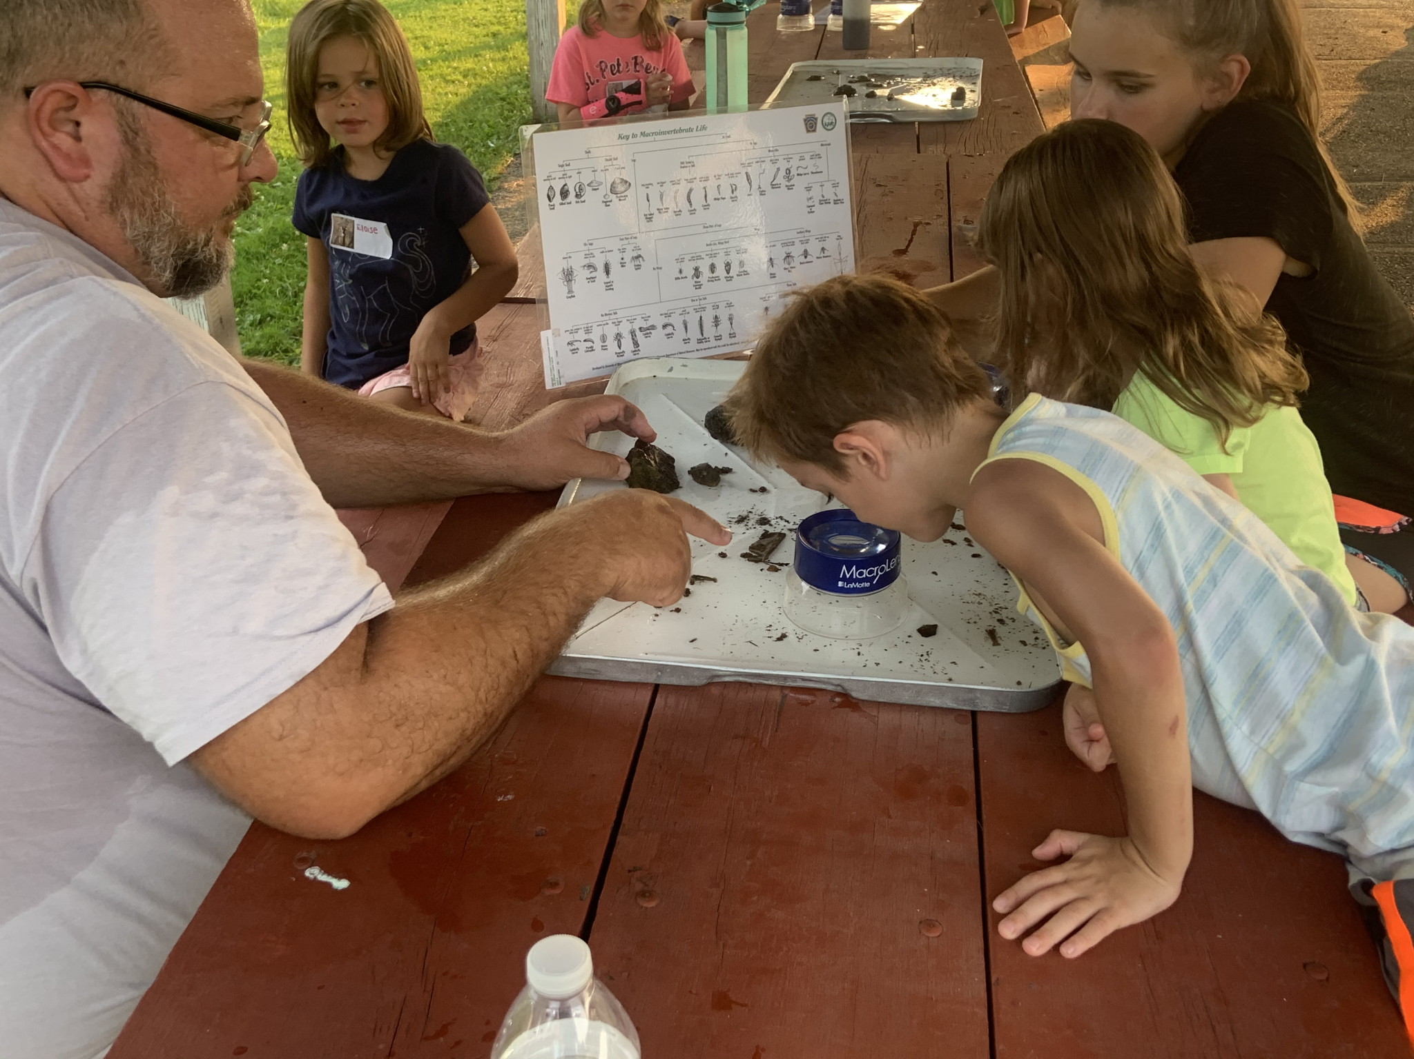
DEP EE Grants Program
Funds environmental education projects that foster an understanding of the natural world and cultivate critical thinking and actions that promote environmental protection and sustainable resource management.
Non-formal programs designed to engage any audience (youth, teachers, farmers, and any other community members)
Formal programs (PreK-12)
Local context
Student led, hands-on action projects
Teacher professional development
Career awareness
State Academic Standards (E&E and STEM)
v
Notes:
Kathleen
Funding is for environmental education.

Slide 60
Pennsylvania Sea Grant & NOAA B-WET
Pennsylvania Sea Grant https://seagrant.psu.edu/
Mission: to promote the sustainability of PA’s ecological and economic coastal watershed resources through science-based research, education, and outreach
Focus areas: healthy coastal ecosystems, resilient communities
and economies, environmental literacy, and workforce development,
sustainable fisheries, and aquaculture
NOAA Bay Watershed Education and Training (B-WET) grants https://www.regions.noaa.gov/great-lakes/index.php/great_lakes-restoration-initiative/accountability/great-lakes-bay-education-and-training-b-wet-program/
Grants for MWEE programs and training across the Great Lakes and Chesapeake Bay regions

Slide 61
Other Funding Ideas
Local businesses, banks, PTA, …
Local foundations
Partnership grant applications - formal & non-formal education organizations
EPA Environmental Education Local Grants by EPA region https://www.epa.gov/education/environmental-education-ee-grants

Slide 62
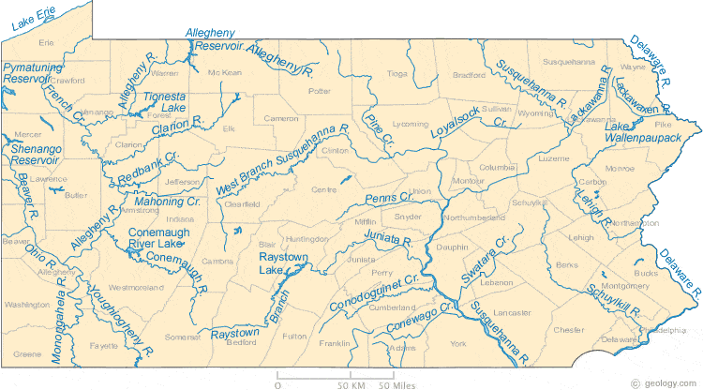
Find Your Next EE Grant!
NAAEE EEPro and sign-up for eeNEWS (regularly includes links to grants) https://naaee.org/eepro
Funding Opportunities listed on Bay Backpack https://baybackpack.com/funding/
Sign up for notifications and create saved searches in Grants.gov, NSF, NASA NSPIRES, and other federal agencies
Some recurring EE-related grants available in PA
PA DEP Environmental Education grants
PA Department of Education eGrants
NOAA Chesapeake B-WET
DCNR grants
PA Department of Agriculture
PA Fish and Boat Commission
National Park Service, Foundation, and Trust
Chesapeake Bay Trust
Notes:
Steve
Look at the responses in the chat window about places to find EE grants.

Slide 63
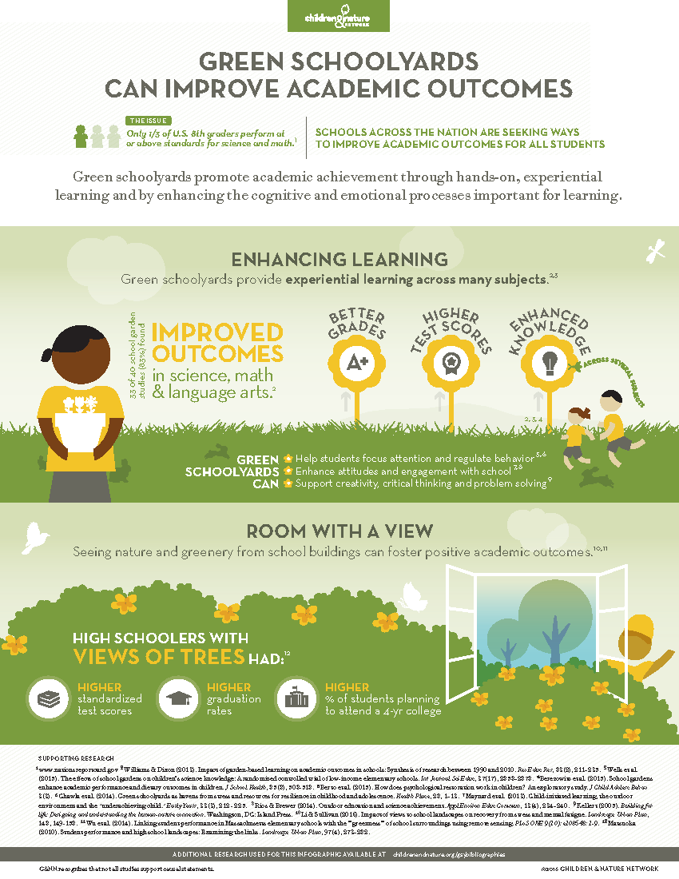
Resources for making the case
Field Experiences for Students
Green Schools Activities
Outdoor Classrooms
Teacher Professional Learning
Coordination & Support
Use these in whole or part as needed and helpful!

Slide 64
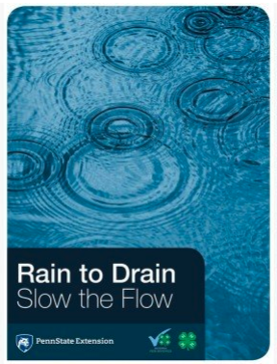
PA Educator Resources

Slide 65
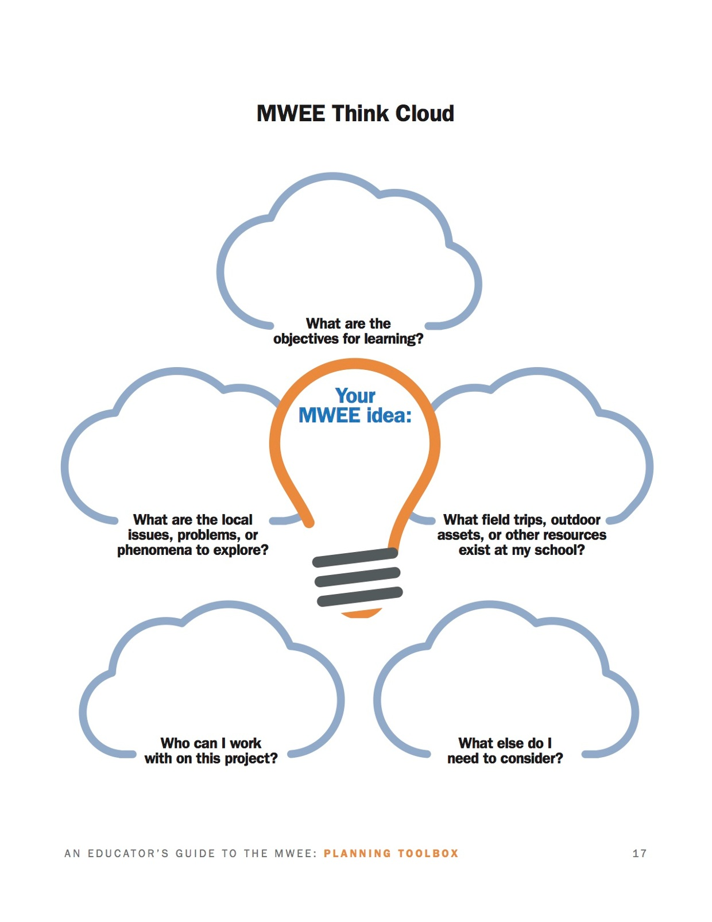
Applying MWEEs to Your Setting
Using the information provided and the “Think Cloud,” start brainstorming how you can take what you already do and fit it in the MWEE framework.
Feel free to ask questions and share/discuss ideas with a neighbor sitting around you!

Slide 66
How do you plan to implement the MWEE framework into your setting?
How do you plan to share this information with your colleagues?
Conclusion & Wrap Up
Discussion Questions:

Slide 67
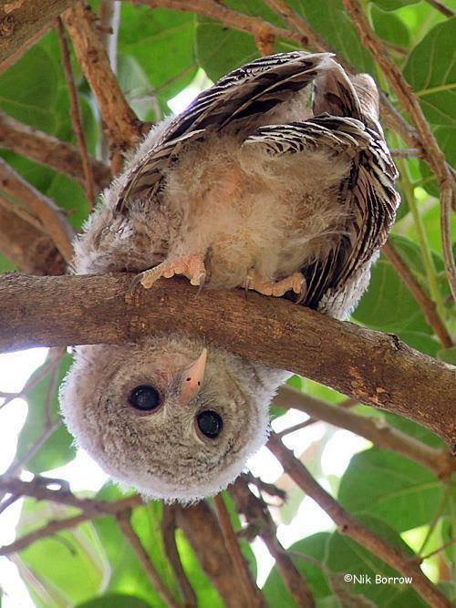
Questions?

Slide 68
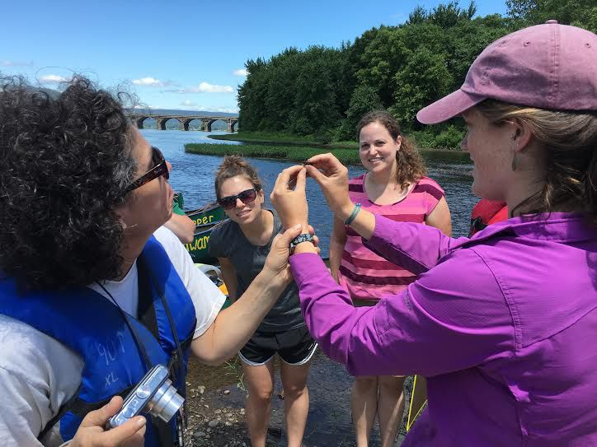
THANK YOU!
Congratulations
MWEE Ambassadors!

Slide 69
This project is funded by NOAA’s Chesapeake Bay Watershed Education and Training Program
To learn more about B-WET visit:
www.noaa.gov/office-education/bwet

Slide 70
Ready to create your first MWEE?
Ready to take an existing MWEE to the next level?
The Chesapeake Bay Program has developed a suite of resources to help!
Educator’s Guide to the MWEE
MWEE 101 Online Course*
Facilitator’s Guide to MWEE Training
Access all of these resources (and more) at www.baybackpack.com
*Act 48 hours available

Slide 71
Additional optional slides

Slide 72
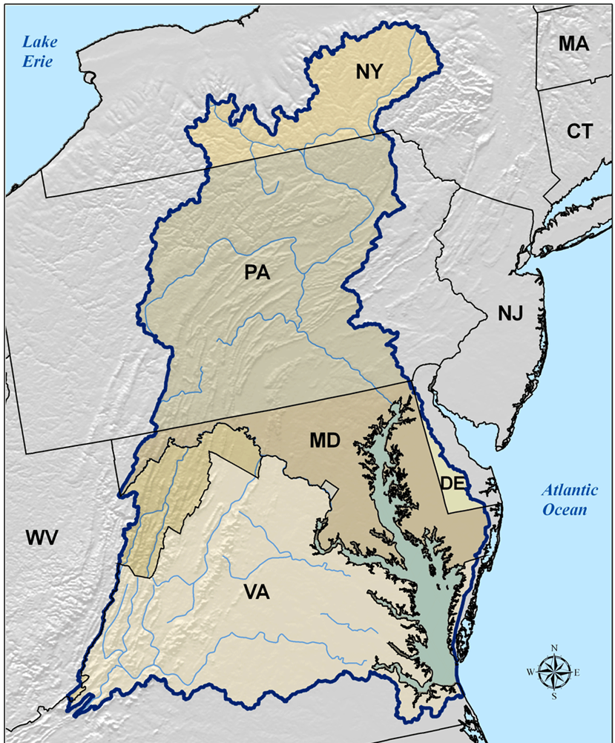
PENNSYLVANIA & THE CHESAPEAKE
Although Pennsylvania doesn't border the Chesapeake Bay, more than half of the state lies within the Chesapeake Bay Watershed.
The Susquehanna River basin is the largest tributary of the Chesapeake Bay.
From its start near Cooperstown, New York, the river flows over 400 miles and empties into the northern portion of the Chesapeake Bay in Maryland.

Slide 73
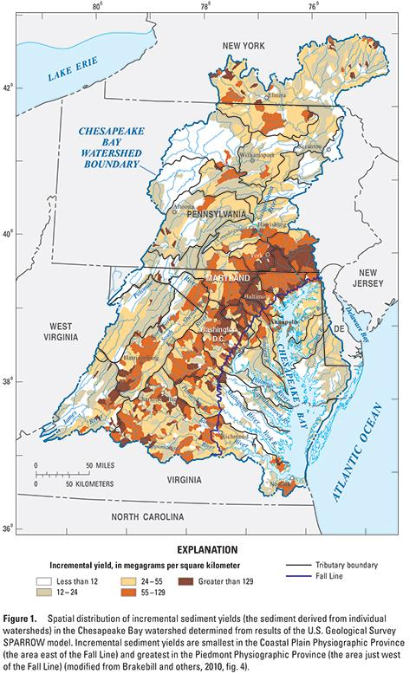
Visualizing PA’s Water Resources - Chesapeake Bay Nutrient & Sediment
Notes:
Nitrogen and sediment issues maps.

Slide 74
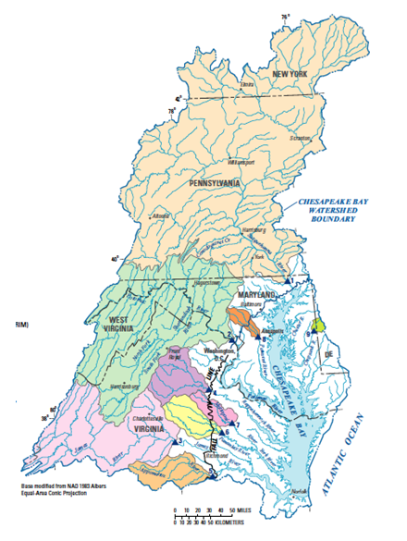
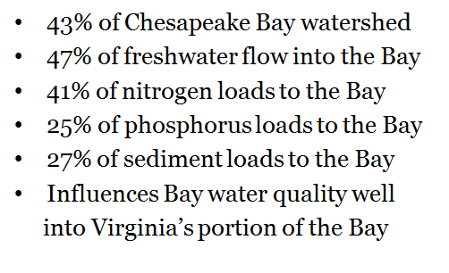
Susquehanna River Has a Major Influence on Chesapeake Bay Water Quality

Slide 75
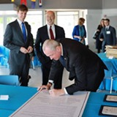
Delaware River Basin Conservation Act (DRBCA) &
Delaware River Basin Commission
2016 Federal act providing technical support and modest funding for local conservation efforts.
2019 proclamation signed by governors of NJ, PA, and DE
to preserve the natural resources of the Delaware River
Basin. Cooperation to:
provide clean drinking water
protect wildlife
address climate change using best science available
help Delaware River Basin Commission (DRBC) (water regulator)
DRBC (NY, DE, PA, NJ, Federal Gov.) (https://www.state.nj.us/drbc/)

Slide 76
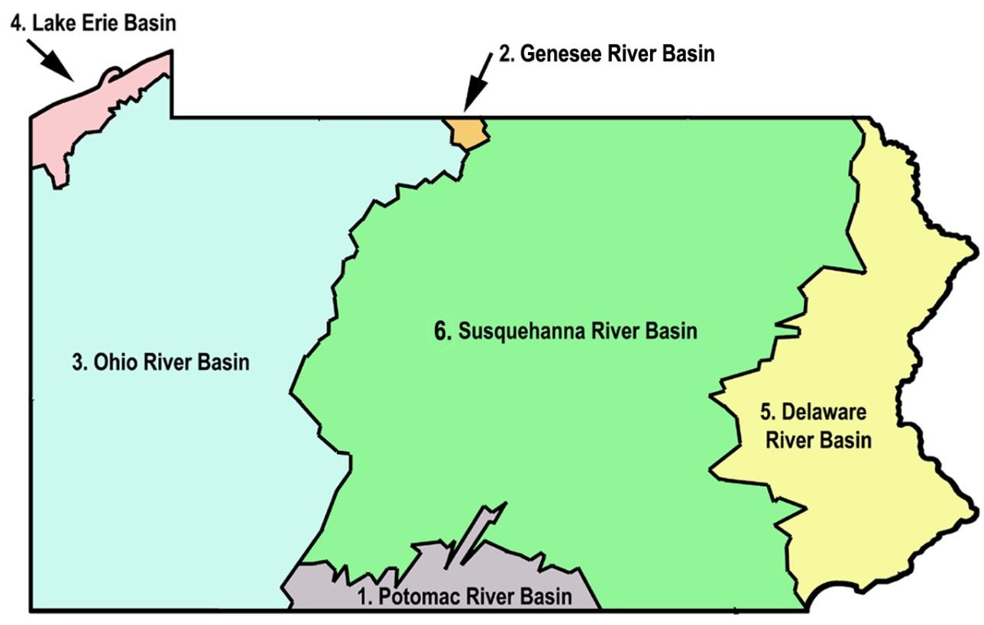
Resources for Ohio Water Basin
Ohio River Basin Alliance(ORBA)
Regional collaborative that includes representatives working to address issues in the ORB.
https://www.lrh.usace.army.mil/Missions/Civil-Works/ORBA/ORBA2/
Ohio River Basin Consortium for Research and Education (ORBCRE)
https://www.ohio.edu/orbcre/basin/index.html
https://www.ohio.edu/orbcre/main1.html
Ohio River Valley Water Sanitation Commission (ORSANCO)
http://www.orsanco.org/about-us/
Notes:
Funding & partnership ideas for Ohio Basin

